Slide 1
The Relationship Between Countermovement Jump Force Time Curve Waveforms and Associated Kinetic Variables in Female Collegiate Division 1 Basketball Athletes
Kya Carroll
06/23/2025

Slide 2
Outline
Introduction
Methods
Results
Discussion
Take-home Message
Acknowledgements

Slide 3
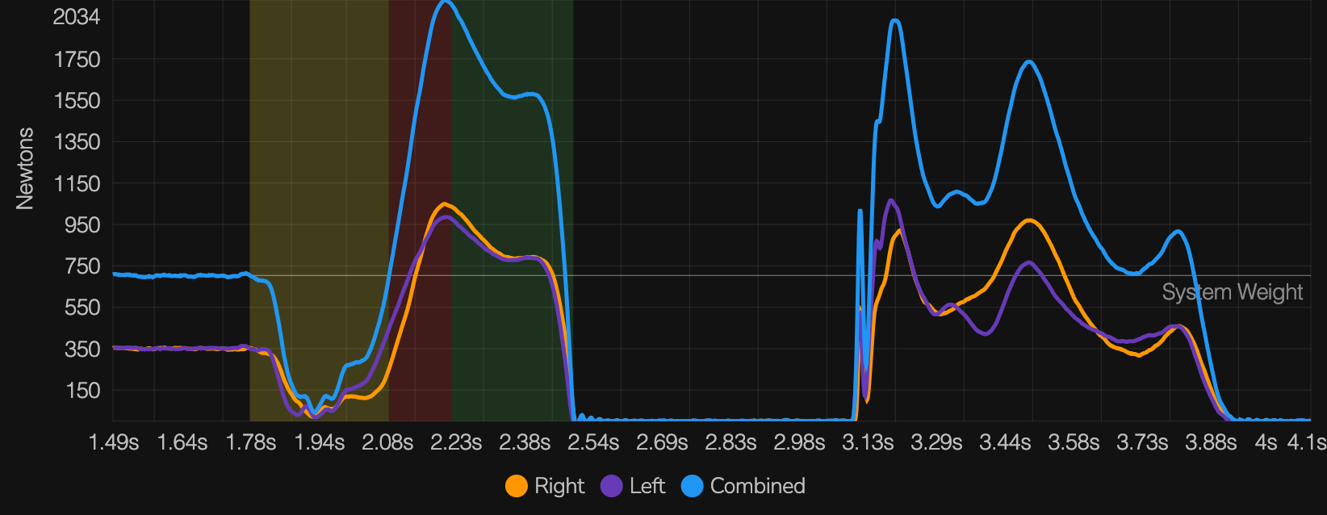
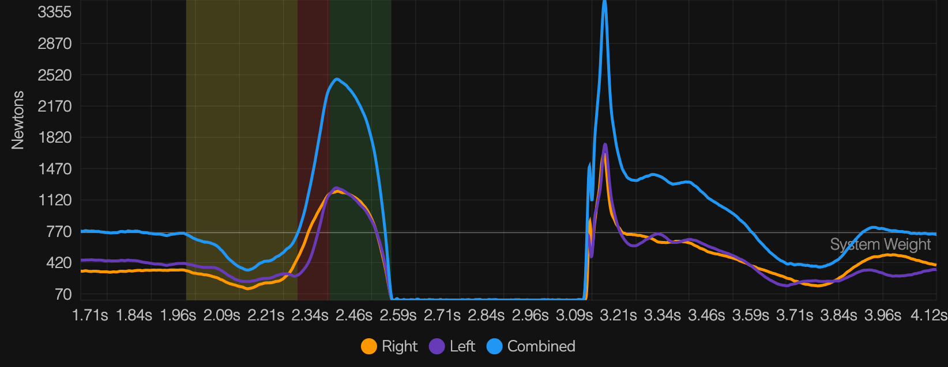
Introduction
Background:
The countermovement jump (CMJ) is a widely used assessment to evaluate basketball athletes' lower-body power and neuromuscular readiness. (mimics the game demands of basketball)
Recently, the shape of the force-time curve has been a popular discussion, which reflects the underlying jump strategy.
Two distinct waveform types—unimodal (single peak) and bimodal (double peak)—have emerged as relevant neuromuscular strategy and efficiency markers.

Slide 4
Introduction
Current Research Understandings:
Muscle Contributions:
Unimodal: Significant Soleus contribution with stable vastus muscle contribution throughout the jump
Bimodal: Significant soleus and vastus muscle contributions during the first peak, and significant contributions of both gastrocnemius and vastus muscles during the second peak of the jump.
Performance differences:
Inconsistencies in the literature
Some research has found:
Bimodal jumps resulted in Higher jump heights, mRSI, and rate of force development compared to unimodal curves (Peng et al)
Better triple extension timing and sequencing
While other research:
Longer unweighting, propulsion, and a more significant center of mass displacement during braking
Less efficient Stretch Shortening cycle due to higher negative-to-positive impulse ratio (NPI)
What’s Missing?
No clear understanding of the mechanism of various jump curves
Inconsistency in results
Lack of a clear understanding of these differences across specific genders and sports
Notes:
Muscle contribution studies: 2023
Peng et al. 2019

Slide 5
Study Purpose/Aims
Study Purpose
The purpose of this study was to examine whether the countermovement jump (CMJ) force-time curve shape (unimodal vs. bimodal) is associated with differences in key CMJ performance metrics in female collegiate basketball athletes.
Hypothesis
Researchers hypothesized that key CMJ performance metrics would differ between individuals with bimodal versus unimodal force-time curve profiles.

Slide 6
Methods – Study Design
Cross-Sectional Study
Examined performance differences between two groups:
Unimodal vs. Bimodal CMJ force-time curve profiles
Athletes categorized based on most consistent waveform type across multiple sessions
Aim: Determine whether curve shape is associated with distinct kinetic outputs

Slide 7
Methods - Subjects
Inclusion Criteria:
Full participation in on-court activities and weight room lifts
9 Female D1 Basketball athletes
6 Guards
3 Posts

Slide 8
Methods - Instrumentation
Force Plates:
Hawkin Dynamics Dual Force plates (1000 Hz)
Data Collection:
Hawkin Dynamics Cloud
Data Cleaning/Analysis:
Microsoft Excel
GraphPad Prism

Slide 9
Methods - Procedures
Testing spanned 5 weeks of NCAA-regulated preseason (20-hour weeks)
Athletes performed 2–3 CMJs per session, 2–3 sessions per week
Jumps conducted on Hawkin Dynamics dual force plates (1000 Hz)
Standardized cue: “Jump as high and fast as possible” with hands on hips
Force-time curves visually classified as unimodal or bimodal
Most consistent waveform across all sessions used for group assignment

Slide 10
Methods – Data Reduction
CMJ testing conducted using Hawkin Dynamics dual force plates (1000 Hz)
Each session: 2–3 jumps per athlete; average taken for analysis
Athletes grouped by consistent waveform type across all sessions
Kinetic variables averaged and reduced using: • Jump Height • Average Relative Propulsive & Braking Force • Relative Peak Propulsive & Braking Power • Time to Takeoff (TTT) • RSI-mod • Countermovement Depth (CMD)
Data analyzed using GraphPad Prism after checking normality (Shapiro-Wilk)

Slide 11
Methods – Data Analysis
Descriptive Statistics (mean +/- SD)
Normality assessed using Shapiro-Wilk test
Group comparisons via independent t-tests (Unimodal vs. Bimodal)
All analyses conducted using GraphPad Prism

Slide 12
Results
Group Breakdown Results:
4 Bimodal
3 guards
1 Post
5 Unimodal
3 guards
2 Posts

Slide 13
Results
Table 1. Descriptive Statistics for CMJ Performance Metrics by Force-Time Curve Classification
**Statistically significant at p < 0.05
Metric | Unimodal (Mean ± SD) | Bimodal (Mean ± SD) | p-value
Jump Height (in) | 12.17 ± 1.3 | 14.26.3 ± 1.5 | 0.000*
Relative Peak Propulsive Power (W/kg) | 49.75 ± 4.2 | 51.85 ± 4.8 | 0.014*
Avg Relative Propulsive Force (N/Kg) | 21.07 ± 1.26 | 20.29 ± 0.97 | 0.000*
Propulsive Phase (s) | 0.221 ± 0.02 | 0.256 ± 0.02 | 0.000*
Relative Peak Braking Power (W/kg) | -19.16 ± 3.7 | -24.9 ± 3.5 | 0.000*
Avg Relative Braking Force (N/kg) | 19.75 ± 2.9 | 20.45 ± 1.6 | 0.018*
Braking Phase (s) | 0.123 ± 0.02 | 0.141 ± 0.02 | 0.000*
Time to Takeoff (s) | 0.641± 0.06 | 0.703± 0.06 | 0.000*
RSI-mod | 0.488 ± 0.06 | 0.519 ± 0.06 | 0.009*
Countermovement Depth (in) | -8.902 ± 1.3 | -12.38 ± 1.3 | 0.000*

Slide 14
Discussion
Unimodal Jumper Characteristics: • Unimodal athletes had higher average relative propulsive force and shallower countermovement depth, suggesting a stiffer, quicker movement strategy. • This aligns with Kennedy et al. (2018), who proposed that unimodal curves reflect more efficient mechanics with reduced displacement and faster SSC transitions.
Notes:
While unimodal athletes showed significantly higher relative propulsive force, the absolute difference was small. This may reflect a stiffer jump strategy, but likely has limited practical impact on jump outcomes compared to braking or power metrics.”
While bimodal athletes produced higher outputs, unimodal profiles may favor speed-driven or reactive movement patterns relevant in team sport settings. • These findings support viewing unimodal strategies as viable and potentially more efficient, depending on context, and not biomechanically inferior.

Slide 15
Discussion
Bimodal Jumper Characteristics: • Bimodal athletes showed higher jump height, braking force, braking power, RSI-mod, and deeper countermovement depth, indicating greater force absorption and output capacity. • These athletes also exhibited longer braking and propulsive phases and greater takeoff time, suggesting a more deliberate movement strategy. • Peng et al. (2019) interpreted bimodal profiles as more effective, highlighting their association with better performance outcomes. • In contrast, Kennedy et al. (2018) suggested that bimodal curves may reflect inefficiencies or compensatory mechanics, such as delayed force production.
Notes:
Peng et al. (2019) interpreted bimodal profiles as more effective, highlighting their association with better performance outcomes. • In contrast, Kennedy et al. (2018) suggested that bimodal curves may reflect inefficiencies or compensatory mechanics, such as delayed force production.
Peng et al. (2019) interpreted bimodal profiles as more effective, highlighting their association with better performance outcomes. • In contrast, Kennedy et al. (2018) suggested that bimodal curves may reflect inefficiencies or compensatory mechanics, such as delayed force production. Our findings suggest that bimodal jumpers may rely on greater movement depth and time to optimize force development

Slide 16
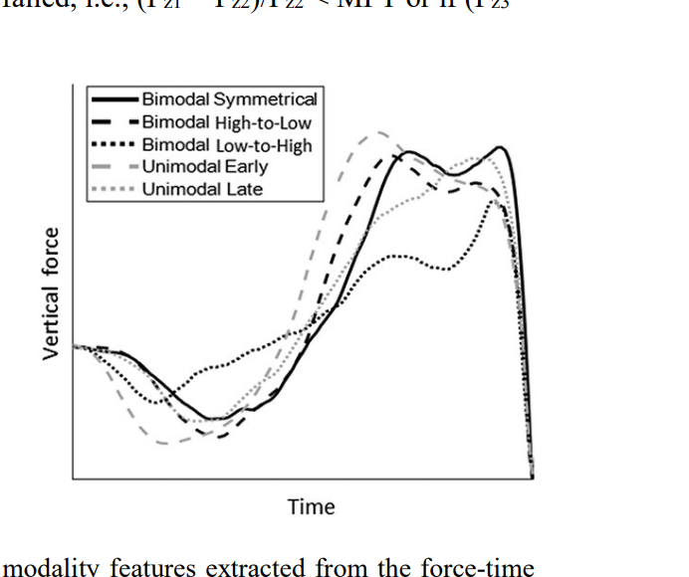
Limitations/Future Research
Small sample size; limits generalizability
Visual classification method may introduce subjectivity
Limited to vertical CMJ in female collegiate basketball athletes
Future studies should: • Include athletes from other sports and positions • Explore curve types across high- vs. low-minute players • Analyze additional force-time patterns • Investigate relationships to injury risk and training responsiveness
Bayne et. al

Slide 17
Take-Home Message
CMJ force-time curve shape reflects distinct jump strategies, not superiority.
Bimodal athletes relied on greater depth, longer movement time, and produced higher power and RSI-mod.
Unimodal athletes used a stiffer, quicker approach with higher relative propulsive force.
Curve shape offers valuable context for individualized athlete profiling, not prescriptive programming.
Practitioners should assess curve patterns in context with role, minutes played, and sport-specific needs.

Slide 18
Acknowledgements
Dr. Tim Suchomel
Dr. Katelyn Allison
Dr. Michelle Van Dyke
University of Pittsburgh’s Women’s Basketball Organization

Slide 19
The Relationship Between Countermovement Jump Force Time Curve Waveforms and Associated Kinetic Variables in Female Collegiate Division 1 Basketball Athletes
Kya Carroll
06/23/2024

